Slide 1
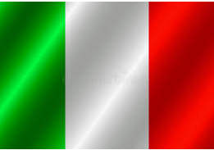
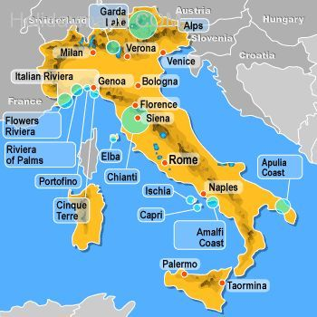
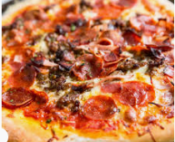
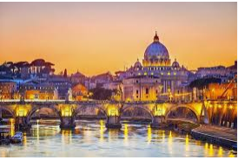
Rome
It is in Italy.
Rome is the capital of Italy.
Italy borders France, Austria, Slovenia and Switzerland.
The continent that Italy is in is Europe.

