Slide 1



KS2 Relationships:
Our Special People
Home Learning: Friends and family
Play this slideshow from beginning
© PSHE Association 2020

Slide 2


    We are learning about what is important in friendships and family relationships
  We will be able to:
identify the qualities of positive friendships and family relationships
explain how friends and family show they care for and value each other
describe what is most important in a friendship or family relationship
recognise that friendships and family relationships may change for different reasons and how to manage this
© PSHE Association 2020

Slide 3
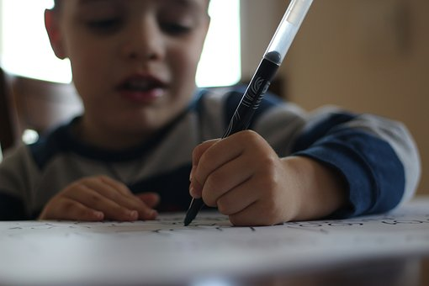

What’s our starting point?
Draw and write
Draw or write about what is most important in a friendship or family relationship?

Slide 4
Special people
My special people
Think about the special people in your life (people you know well).
What do they do that makes them special to you?
Make a brainstorm, mind-map or word cloud about special people.
You don’t have to name anyone, but think about your own special people as you do this activity.
© PSHE Association 2020

Slide 5
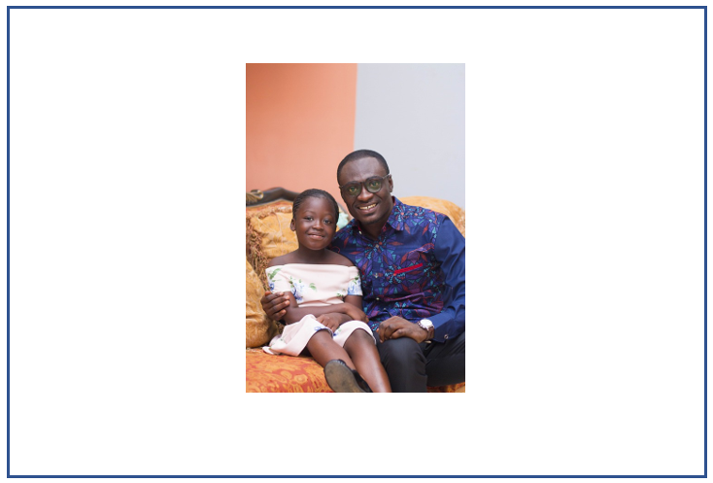
Your special people
Draw a picture of you with your special person (or use a photograph if you have one). Around the outside of the picture write down all the ‘qualities’ of the relationship e.g. trust, loyalty…
Repeat this activity twice more. Choose a different special person each time.
Are there similar qualities in each relationship?
© PSHE Association 2020

Slide 6
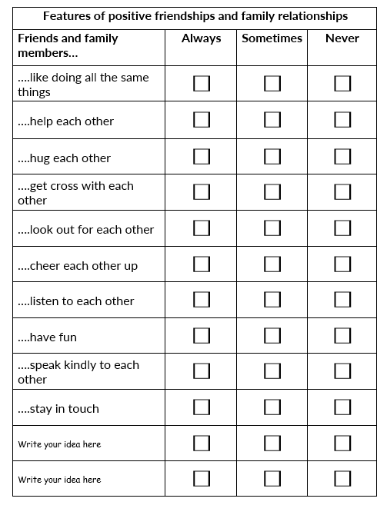
Features of friendships
Complete the grid about the features of positive friendships and family relationships using Resource 1 in your worksheet pack (print off or type on the sheet).
Tick all the relevant boxes.
© PSHE Association 2020

Slide 7
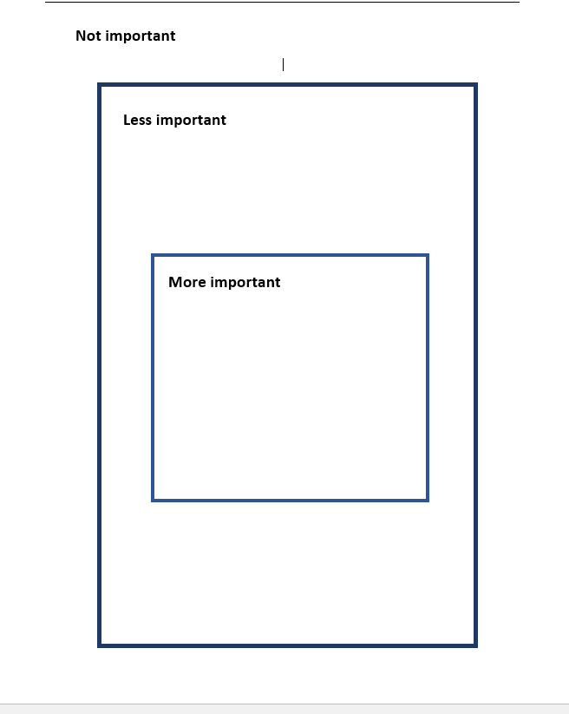
What is most important?
Now look at the zone of relevance activity (Resource 2) in your worksheet pack.
What is most important in a positive friendship or family relationship?
Sort the statements.
Put the things you think are most important for you in the centre square and the less important things in the outer square (print off, type on the sheet or draw on a piece of paper).
Making each other laugh
Giving presents
Being kind

Slide 8
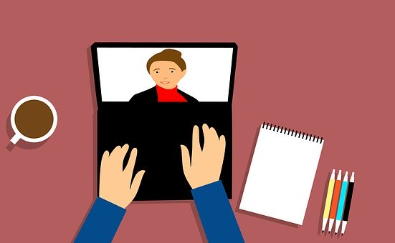
Friends, family and change
Sometimes things happen that mean a friendship or family situation changes. This might also mean that people don’t see their special people as often, or as much, as they would like.
Read the friend and family scenarios (Resource 3) in your worksheet pack.
What could the characters do to let their special people know how much they miss them and still care about them?
Think of some ideas to help them.
© PSHE Association 2020

Slide 9
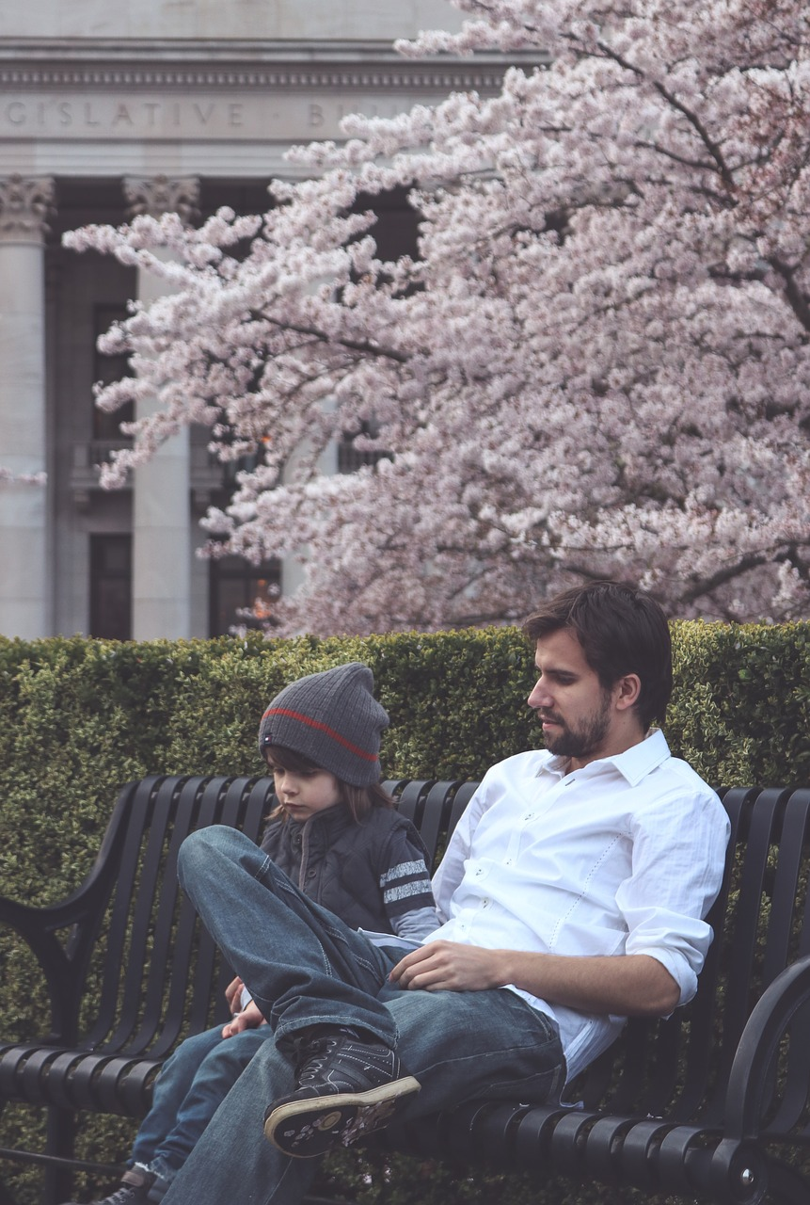
Missing someone special
When we can’t see our special people as often as we would like, it can make us feel sad or we might feel worried or concerned for them.
If you miss seeing someone special a lot or you feel worried about somebody you don’t see very often, remember to talk to an adult you trust – your mum, dad or the person who looks after you.
If you feel you don’t have anyone to talk to, you can always call ChildLine on 0800 1111 where trained counsellors can give you advice.
© PSHE Association 2020

Slide 10


Special People – Friends and Family
Where are we now?
Well done on completing the activities!
Now go back to the ‘What’s your starting point?’ activity.
Draw or write about what is most important in a friendship or family relationship.
Is there anything you would like to change?
Is there anything you would like to add?
© PSHE Association 2020

Slide 11

Additional activity
Give me 5!
If someone (a special person) is far away or we don’t see them that often, what are some fun ways to let them know we still care?
Think of five different ideas!
© PSHE Association 2020

