Slide 1
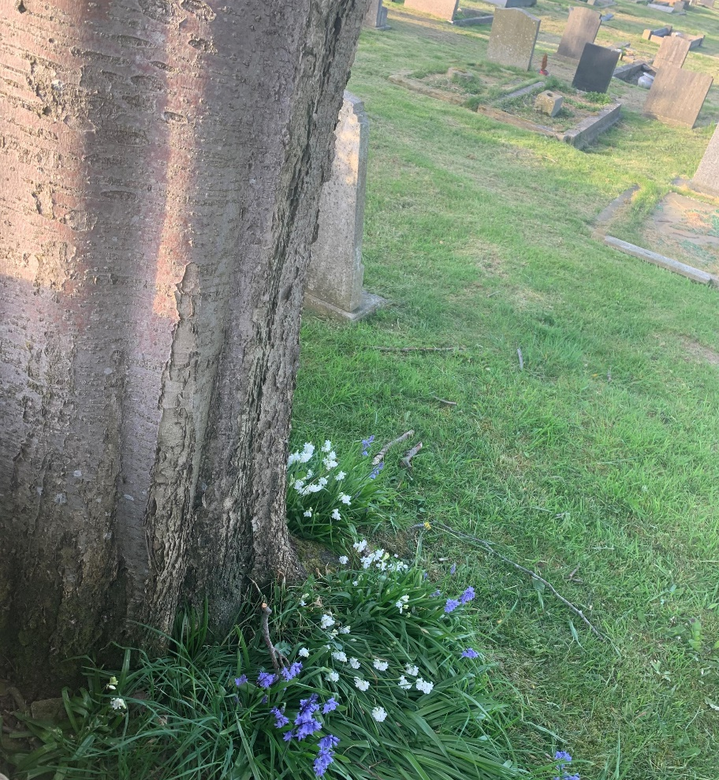
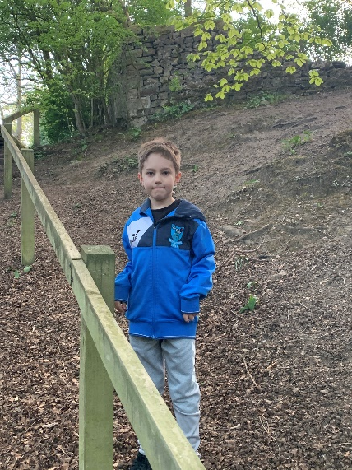
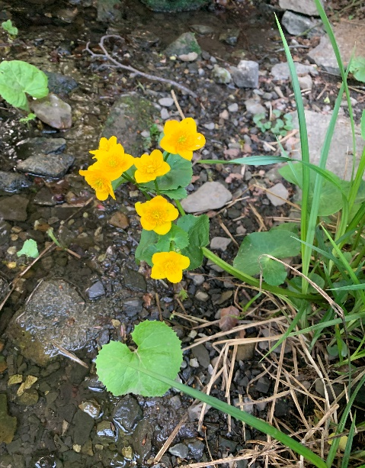
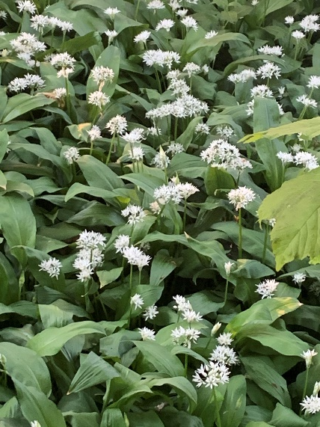
FLOWERS
Wild Garlic
Forget me not
Greater celandine
Whitebells and bluebells
Cowslip
Red campion
celandine
These are what I have found on my walks

